Slide 1
SDLC (Software Development LifeCycle)
SDLC is a process used to develop high-quality software efficiently, within budget and on time.

Slide 2
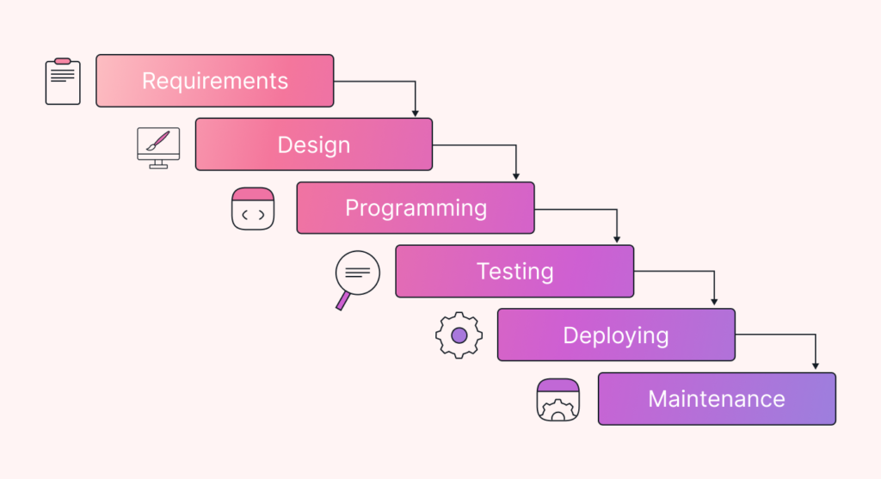
Waterfall Model

Slide 3
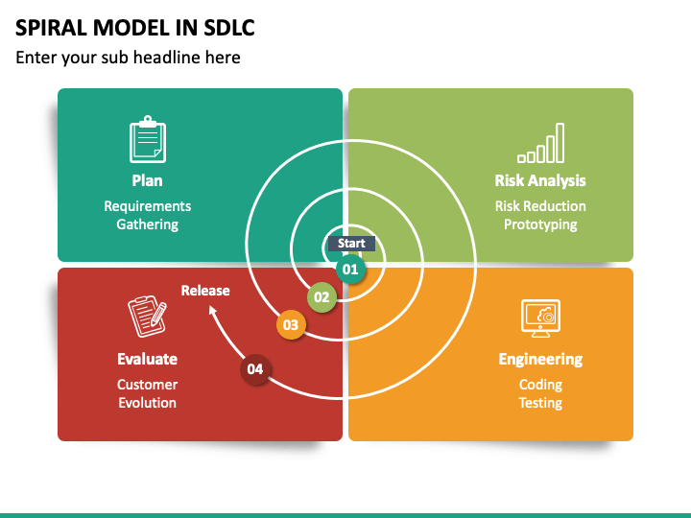
Spiral Model

Slide 4
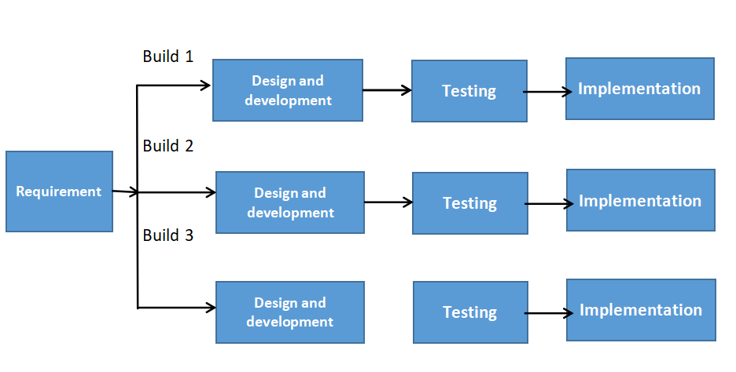
Iterative Model

Slide 5
Problems in previous models
Lack of flexibility - Couldn’t adapt to changing customer requirements
Late Testing - Testing occurs after development which might increase the number of critical errors
High Cost - If final product doesn’t satisfy customer we’ve to redo the process
Lack of Customer Feedback - Feedback is taken at the beginning, after that it is taken directly at the end of the process

Slide 6
Which method is correct?
Agile
Flexibility & Adaptability - Ensures product adjusts according to changing customer demands
Faster Delivery - Due to the sprint system, software delivery time reduces
Reduced Risk & Failure - Due to multiple iterations, chances of failures / errors are reduced
Better Collaboration - Agile supports better communication between customers and enhances collaborative spirit between development teams

Slide 7
THANK YOU
Siddharth Govardhane

